Slide 1
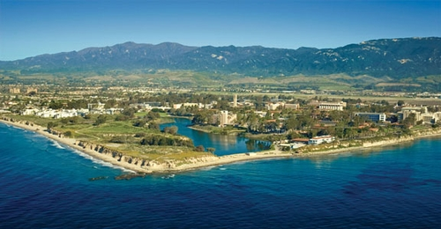
The 2nd Round of the NIST PQC Standardization Process
Dustin Moody
Notes:
Welcome. Thank you to all the authors, teams, panelists, attendees.

Slide 2
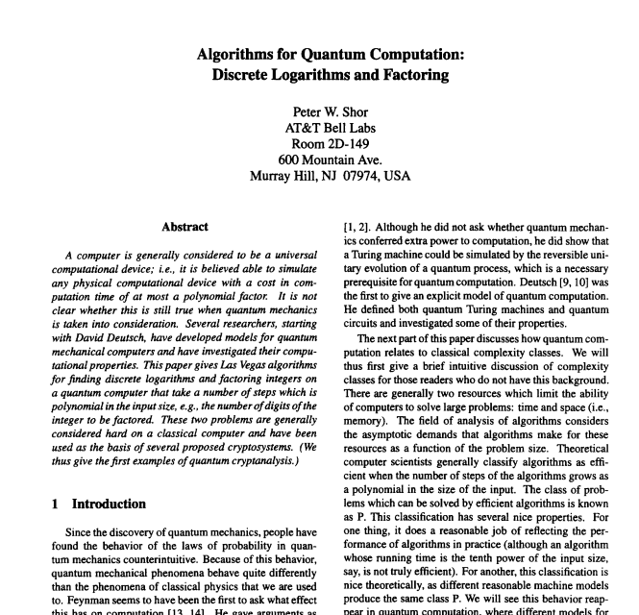
How we got here…
NIST’s public-key crypto standards
FIPS 186, The Digital Signature Standard
SP 800-56 A/B, Recommendation for Pair-Wise Key Establishment Schemes Using Discrete Logarithm/Integer Factorization Cryptography
Quantum computers and Shor’s Algorithm

Slide 3
How we got here…
2006 – 1st PQCrypto conference in Leuven, Belgium
2009 – NIST PQC survey Quantum Resistant Public Key Cryptography: A Survey [Perlner, Cooper]
2012 – NIST begins PQC project
Apr 2015 – NIST Workshop on Cybersecurity in a Post-Quantum World
Aug 2015 – NSA announcement
Feb 2016 – NIST Report on PQC (NISTIR 8105)
Feb 2016 – NIST announcement of “competition-like process” at PQCrypto in Japan
Dec 2016 – Final requirements and evaluation criteria published
Nov 2017 – Deadline for Submissions
Dec 2017 – Round 1 begins – 69 candidates accepted as “complete and proper”
Apr 2018 – 1st NIST PQC Standardization Workshop
Jan 2019 – Round 2 candidates announced
Aug 2019 – 2nd NIST PQC Standardization Workshop
Notes:
Not to say others not doing anything
10th PQCrypto this year in Chongqing, China

Slide 4
The “Competition”
Scope:
Digital Signatures
EUF-CMA up to 2⁶⁴ signature queries
Public-key Encryption / Key-Encapsulation Mechanisms (KEMs)
IND-CCA up to 2⁶⁴ decryption/decapsulation queries
IND-CPA option
Open and transparent process
Unlike previous AES and SHA-3 competitions, there will not be a single “winner”

Slide 5
Evaluation Criteria
Security – against both classical and quantum attacks
NIST asked submitters to focus on levels 1,2, and 3. (Levels 4 and 5 are for very high security)
Performance – measured on various classical platforms
Other properties: Drop-in replacements, Perfect forward secrecy, Resistance to side-channel attacks, Simplicity and flexibility, Misuse resistance, etc.
Level | Security Description
I | At least as hard to break as AES128 (exhaustive key search)
II | At least as hard to break as SHA256 (collision search)
III | At least as hard to break as AES192 (exhaustive key search)
IV | At least as hard to break as SHA384 (collision search)
V | At least as hard to break as AES256 (exhaustive key search)
Notes:
These are understood to be preliminary estimates

Slide 6
The 1st Round Candidates
82 submissions received.
69 accepted as “complete and proper” (5 withdrew)
 | Signatures | KEM/Encryption | Overall
Lattice-based | 5 | 21 | 26
Code-based | 2 | 17 | 19
Multi-variate | 7 | 2 | 9
Symmetric-based | 3 |  | 3
Other | 2 | 5 | 7
Total | 19 | 45 | 64

Slide 7
The 1st Round 2nd Round Candidates
 | Signatures |  | KEM/Encryption |  | Overall
Lattice-based | 5 | 3 | 21 | 9 | 26 | 12
Code-based | 2 | 0 | 17 | 7 | 19 | 7
Multi-variate | 7 | 4 | 2 | 0 | 9 | 4
Symmetric-based | 3 | 2 |  |  | 3 | 2
Other | 2 | 0 | 5 | 1 | 7 | 1
Total | 19 | 9 | 45 | 17 | 64 | 26

Slide 8
The Second Round (and beyond)
Aug 22-24, 2019 – 2nd NIST PQC Standardization workshop, co-located with CRYPTO in Santa Barbara, CA
Expected to last 12-18 months, after likely a 3rd Round
Overall timeline: we still expect draft standards around 2022ish
(but reserve the right to change this!)

Slide 9
Stateful Hash-based signatures
NIST plans to approve stateful hash-based signatures
1) XMSS, specified in RFC 8931
2) LMS, specified in RFC 8554
Will include their multi-tree variants, XMSS^MT and HSS
In Feb 2019, NIST issued a request for public input on how to mitigate the potential misuse of stateful HBS schemes.
See comments received here
Will recommend HBS schemes limited to scenarios in which a digital signature scheme needs to be deployed soon, but where risks of accidental one-time key reuse can be minimized
NIST expects to have a draft Special Publication (SP) published by the end of 2019
Notes:
Most comments offering advice, caution. Adam said probably not worth it.

Slide 10
What NIST wants
Performance (hardware+software) will play more of a role
More benchmarks
For hardware, NIST asks to focus on Cortex M4 (with all options) and Artix-7
pqc-hardware-forum
How do schemes perform on constrained devices?
Side-channel analysis (concrete attacks, protection, etc…)
Continued research and analysis on ALL of the 2nd round candidates
See how submissions fit into applications/procotols. Any constraints?
Notes:
We are looking for mature schemes
-- We still would prefer MUCH more hardware analysis -- The PQC-Hardware-Forum is open, but not used yet [[This is the "primary point in time" that we could encourage kicking off more discussion there..]] 1) PERFORMANCE: How do the schemes perform on constrained hardware? Do they all "fit"? Are there large changes in performance vs. the software implementations we already have? 2) SECURITY: Side-channel analysis -- this area is still /mostly/ wide-open. We are listening intently for any work on side-channel attacks and side-channel resilience. Please give us: a) New side-channel attacks on the concrete candidates, evaluate this in practice! b) Theoretical, high-level analysis of how resistant these schemes' hardness assumptions are to side-channel attacks c) Practical "side-channel masking" -- either "masked implementations," "re-ordering of algorithms' code to prevent attacks," etc.

Slide 11
Summary
Round 2 is ongoing….
26 candidate algorithms (17 encryption/KEM, 9 signatures)
We will continue to work in an open and transparent manner with the crypto community for PQC standards
Check out: www.nist.gov/pqcrypto
Sign up for the pqc-forum
Talk to us: pqc-comments@nist.gov

